Slide 1


Fall Membership Meeting
October 15 2025

Slide 2

Agenda
• Welcome
• Election of a New President
• President’s Report
• Budget Report
• Graduating Class of 2026
• Service Awards
• VCE Extension
• Keynote Speaker

Slide 3
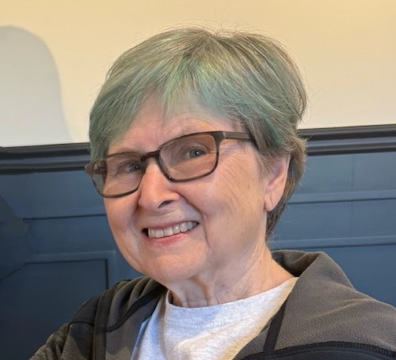
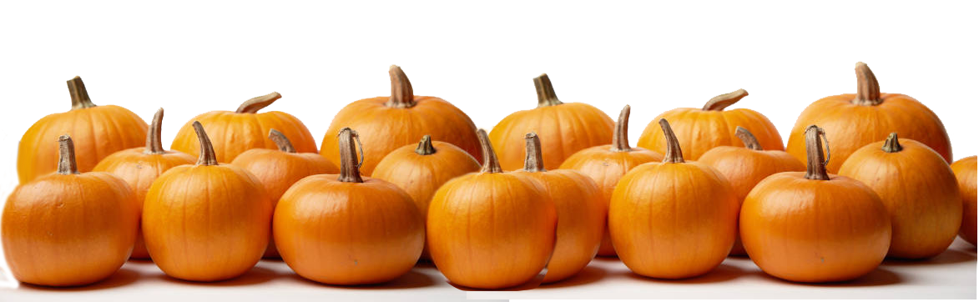
Susan McCrackin retired from the world of student financial aid in 2019 after 20 years at the College Board.
Susan served as part of the Training Team during the Covid years and was elected to serve as the VP for Training in 2025. She has served as FCMGA President since July 2025. Susan is active in her church where she supports the gardening team and performs as part of the handbell ringers.
Susan has a passion for gardening and is never as happy as when she is working in her garden.
Susan McCrackin

Slide 4

Board of Directors 2025-2026
VP Membership
VP Operations
VP Training
VP Marketing
Treasurer
Secretary
Corresponding Secretary
Past President ex officio
• Karen & Simon Bell
• Ernie Ruckert
• Carlotta Moulder
• Vacant
• Brooke Span
• Taunia Schulke
• Terry Ginda
• Christie Nix

Slide 5
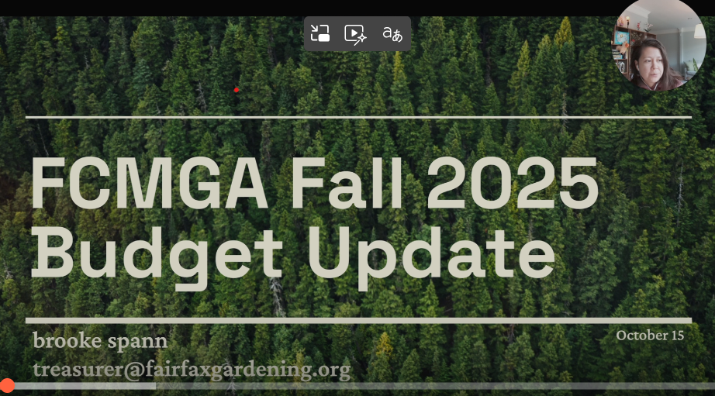

Slide 6
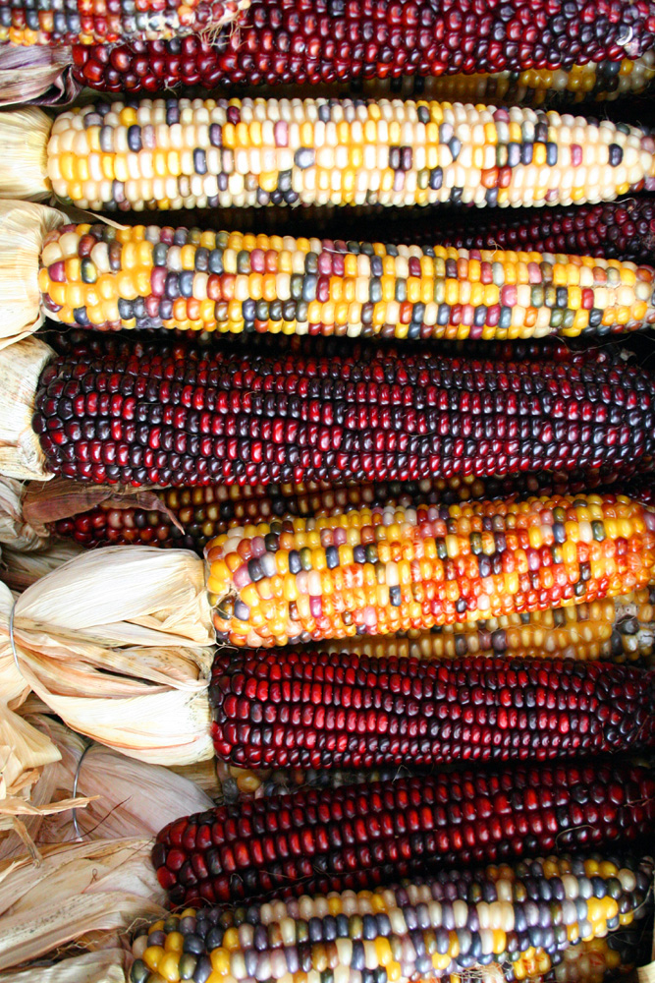
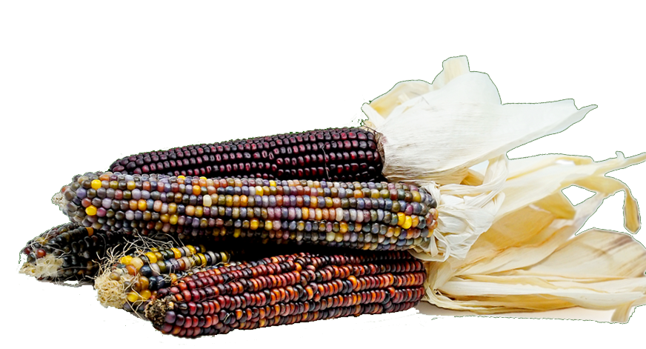
Renewing Registration for 2026
1. Register in Better Impact
Update your information
Complete other requirements
2. Pay your membership fee

Slide 7
How to Pay
• By Mail
Print and complete the form
Send it with your payment check to:
FCMGA Enrollment
PO Box 2033
Merrifield, VA 22116
• Online
members.FairfaxGardening.org/registration-2026
Fill out the renewal form online
Pay online using your credit

Slide 8
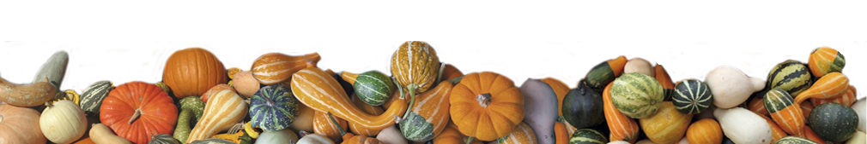
VP for Marketing
• Are you adept at social media?
• Can you work well with people and manage multiple projects?
• Do you have some experience in or a love for
Marketing
Graphic Design
PR?
• Do you love telling people about FCMGA?
• Are you eager to serve FCMGA and the residents of Fairfax County?

Slide 9
VP for Marketing Position Open!
Complete the 2025-2026 term
Work with a great team that is already highly functioning
Please contact Susan McCrackin: president@FairfaxGardening.org
We want to hear from you!

Slide 10
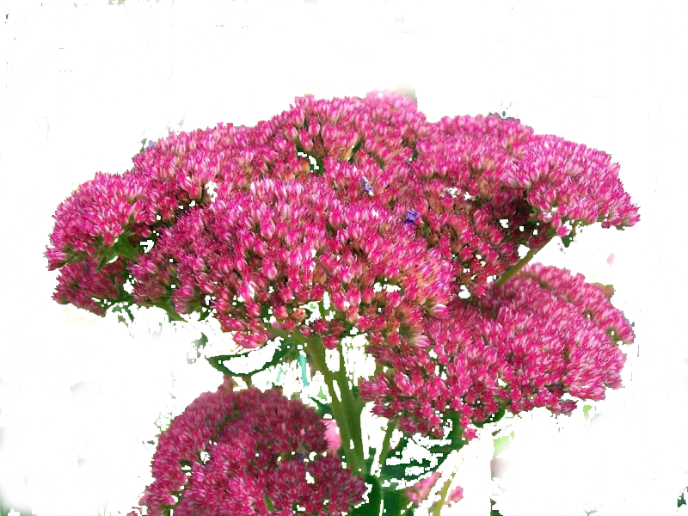
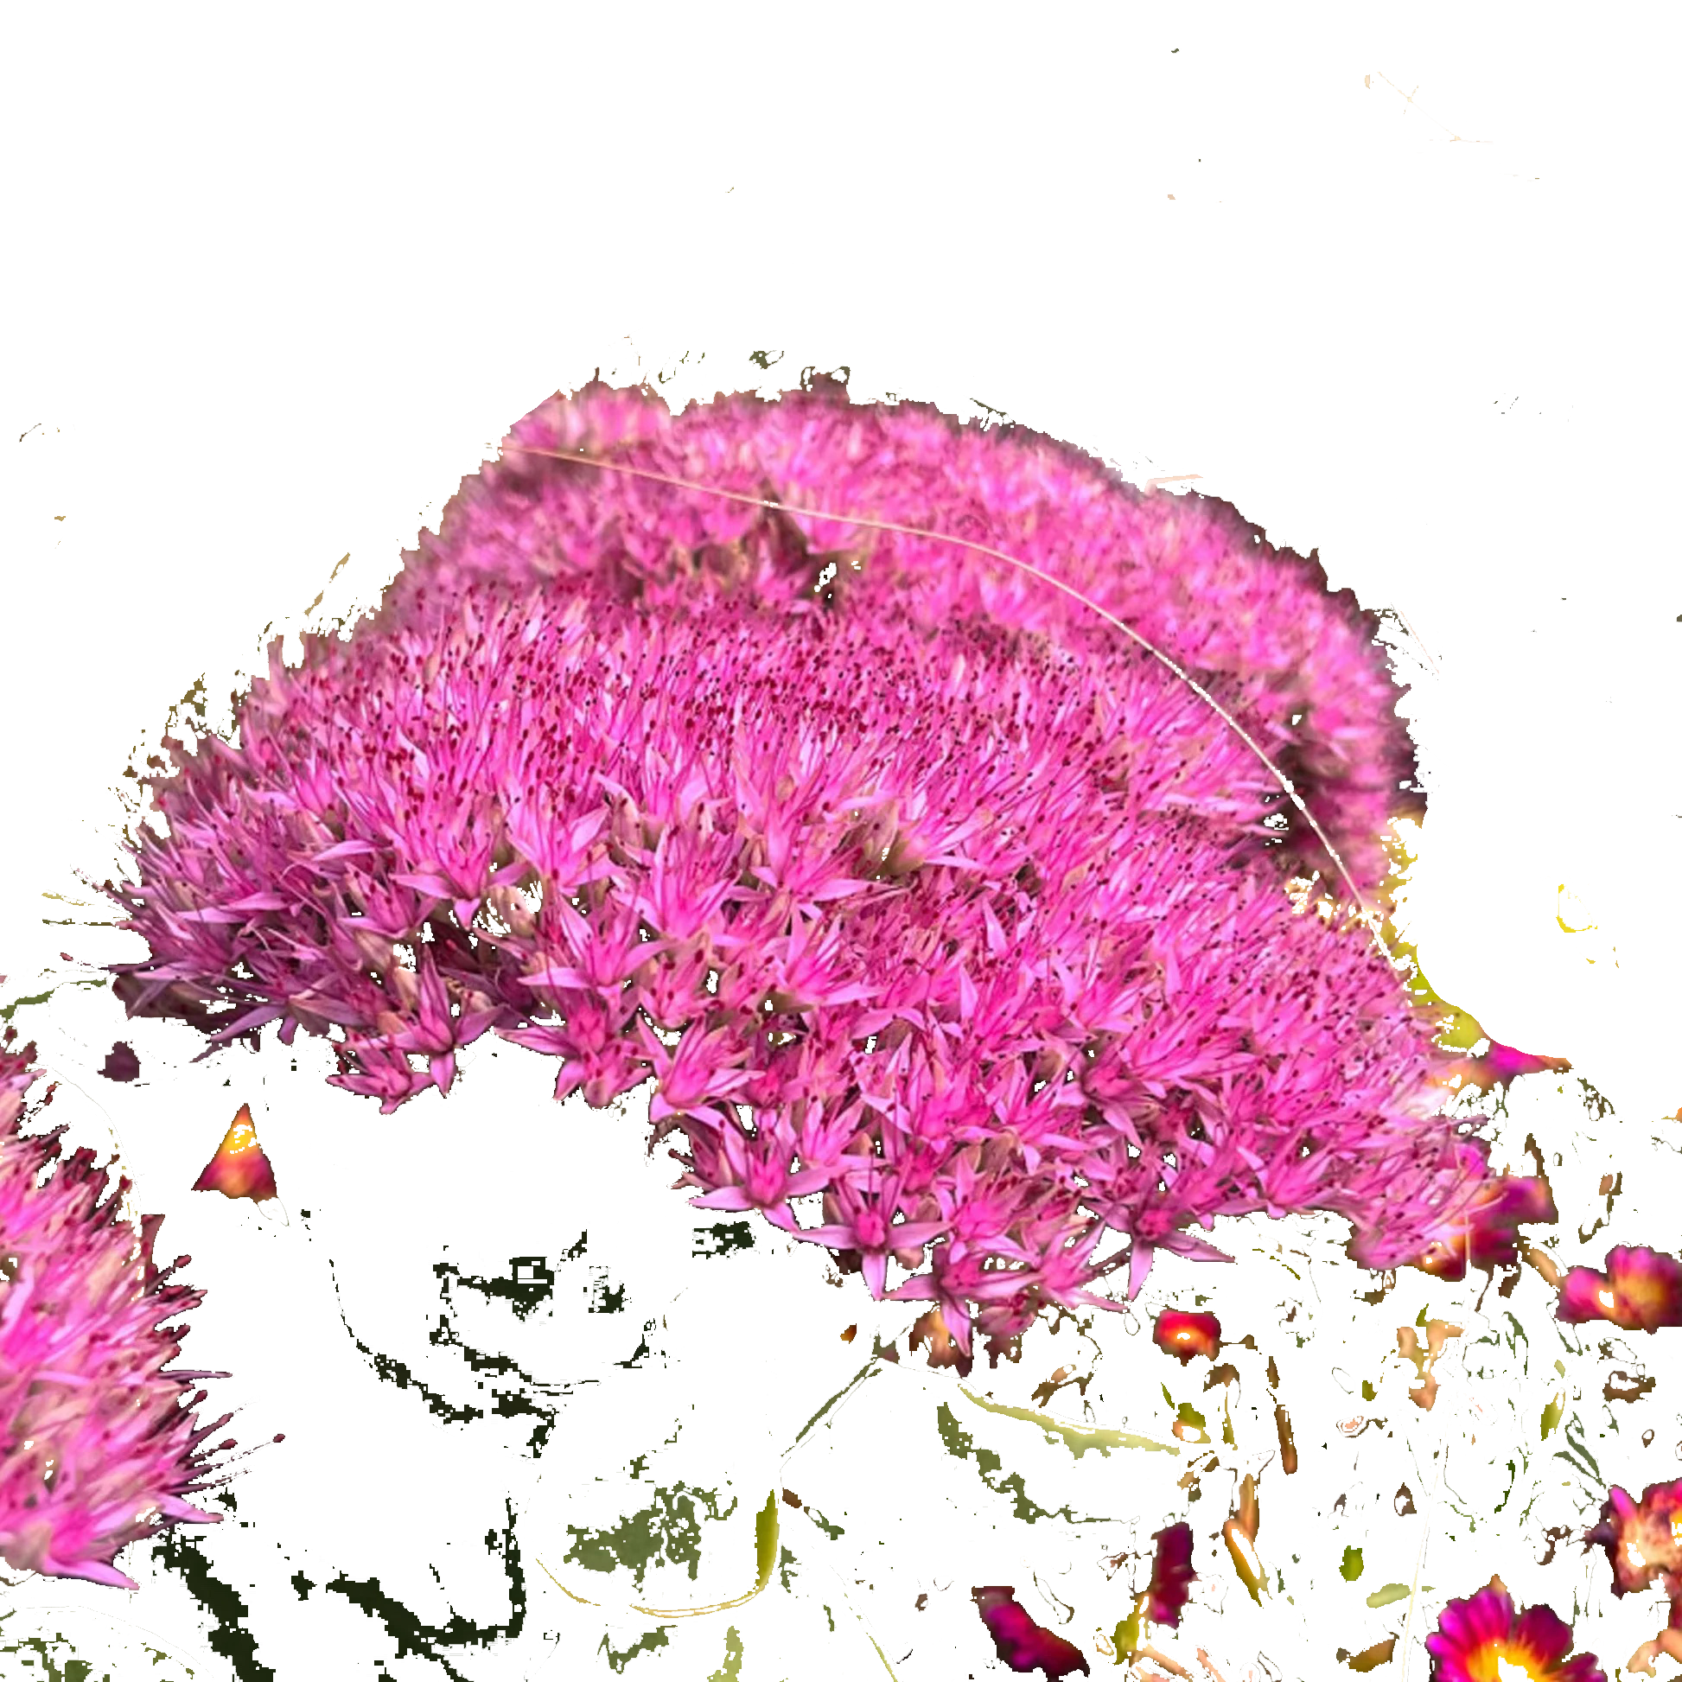
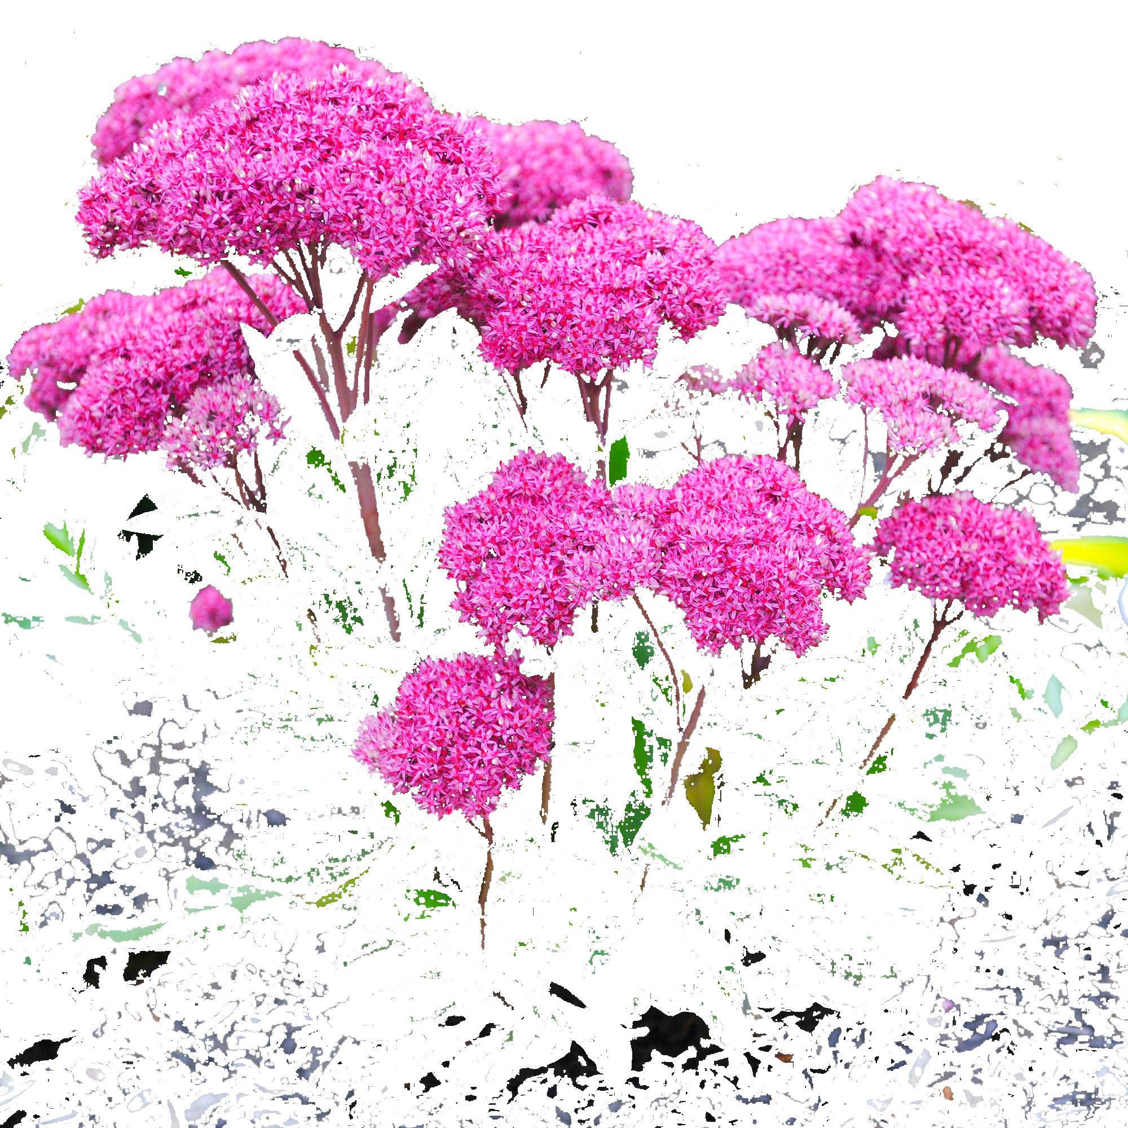

Volunteers Needed
• VCE Help Desk
• Garden Plot Coordinator
• George Mason Park Community Garden Plot
• Nottoway Park Community Garden Plot (2)
• Special Events
• Oakton Library Plant Clinic
• Annandale Farmers Market Plant Clinic
• Mt. Vernon Farmers Market Plant Clinic
• Reston Farmers Market Plant Clinic

Slide 11
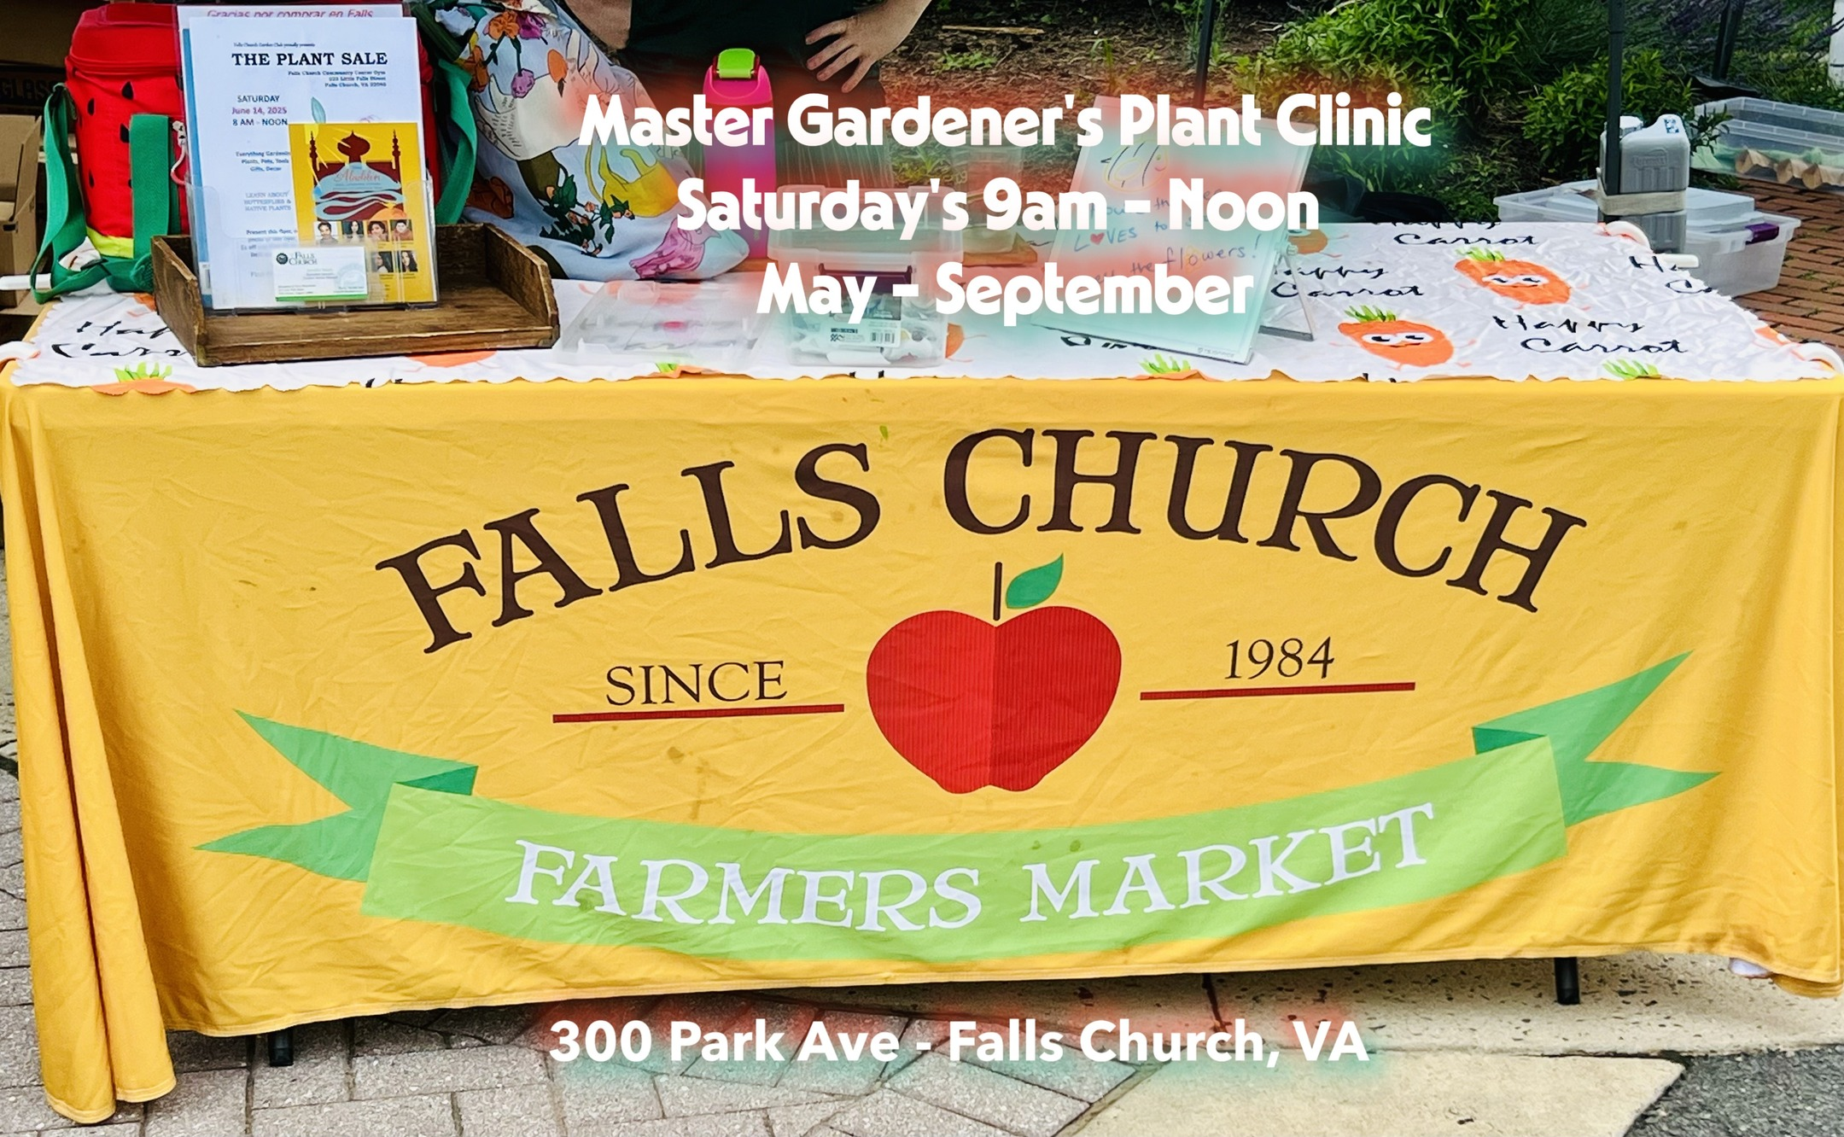
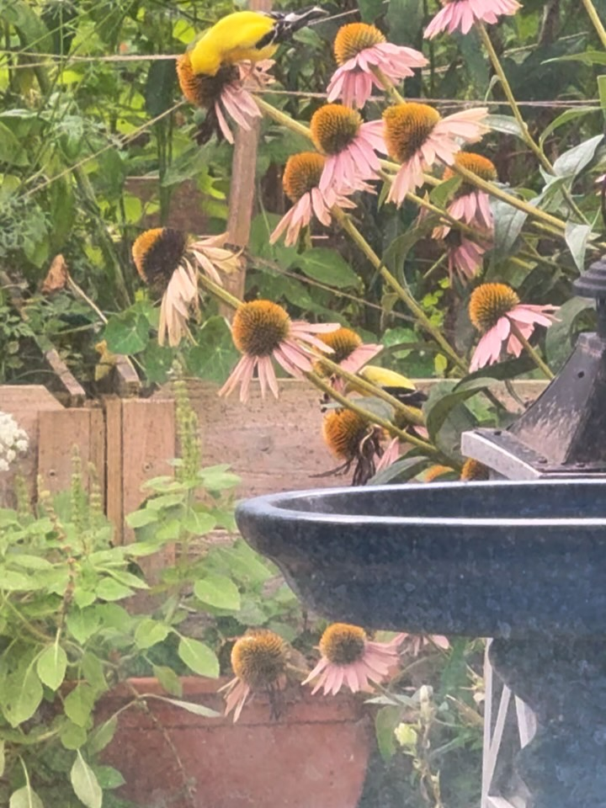
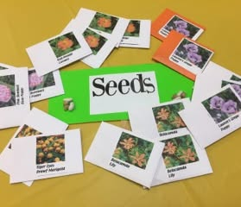
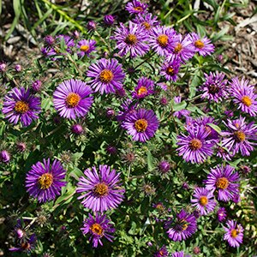


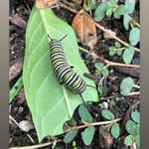
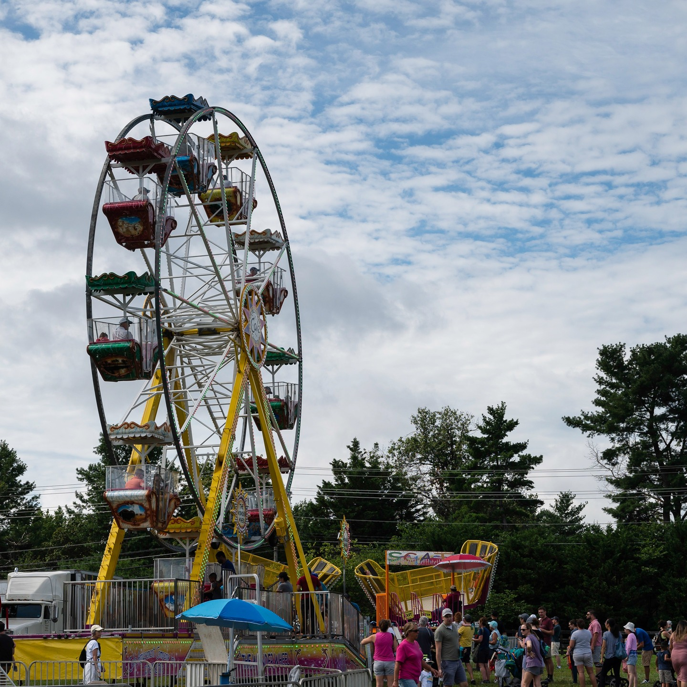
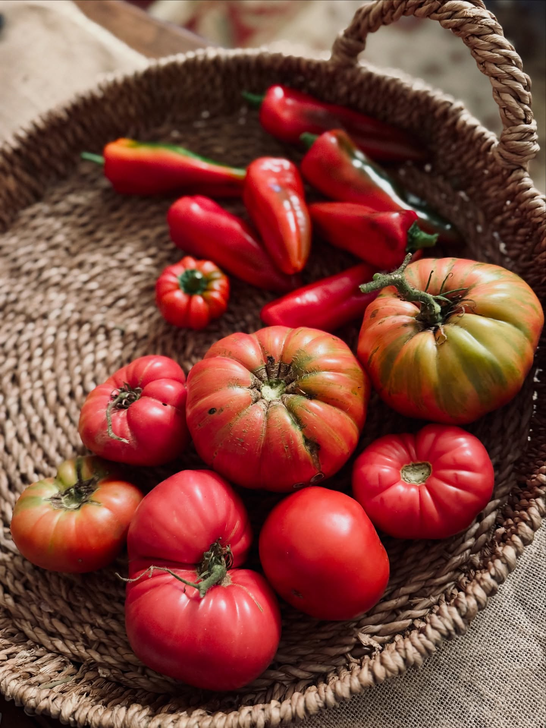

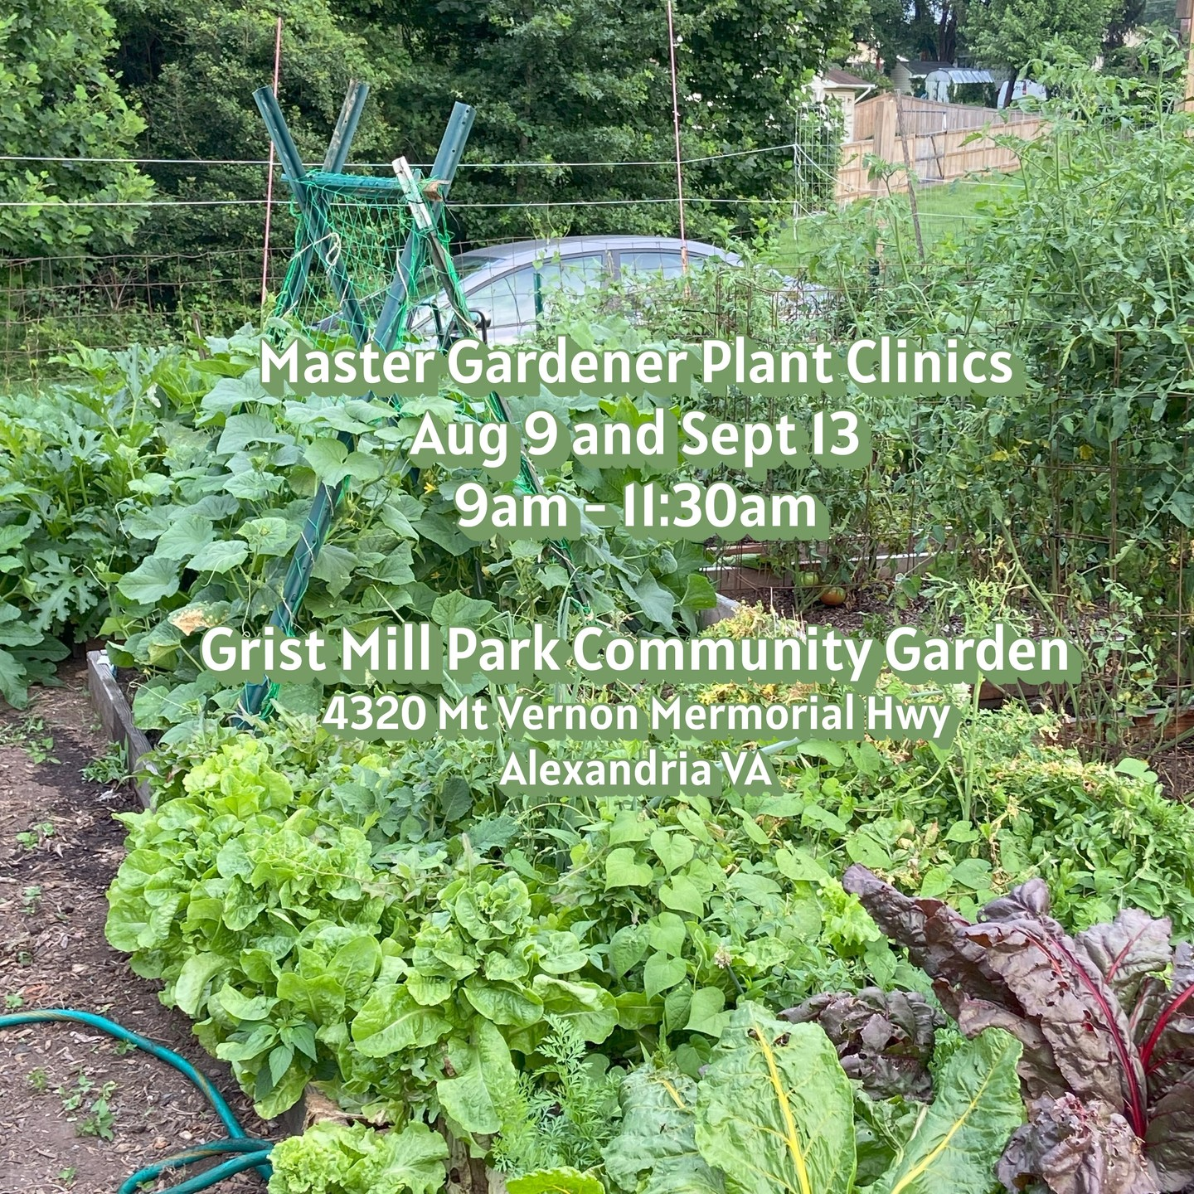
Joint Program Visibility through website & social media
FCMGA in-person events
Home Food Production
KPI and Analytics

Slide 12
Social Media – How you can help!
Help build our photo catalog
Send High-quality Visuals/Photos to: cramoski122@gmail.com
Writers; Reels & Stories, Storytelling
Graphics, Canva
Copywriting
Just interested in learning social media
Talk to us during the break!
Christine Ramoski
Lauren Terrell
Katie Racine
Attend Virtual Recruitment Meeting: Targeting 10/29
All members are encouraged to like, share, and follow!
https://www.instagram.com/fairfax.master.gardeners/
https://www.facebook.com/FairfaxCountyMasterGardeners/

Slide 13
Quiz: Which was true for 1976?
1. 1976 was the United State’s bicentennial year.
2. 1976 was the year that Susan McCrackin graduated from college.
3. 1976 was the year that Apple Computer was founded.
Answer:
They are ALL TRUE!
But, in 1976, there was an even MORE momentous event:

Slide 14
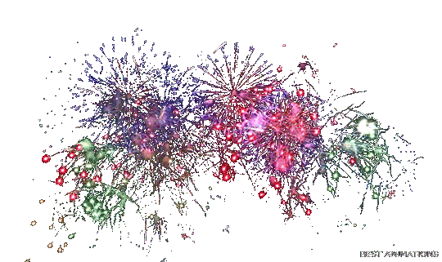

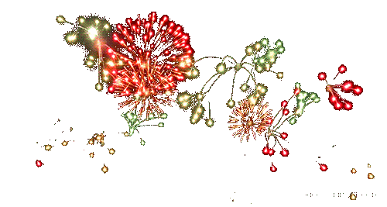
FCMGA Was Founded!
Thanks to Justine Frank for designing the logo!
The Party Is Just Starting!

Slide 15
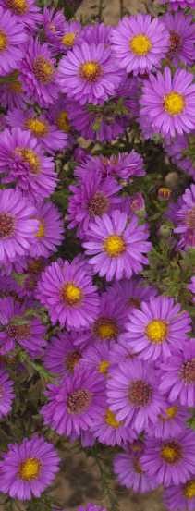
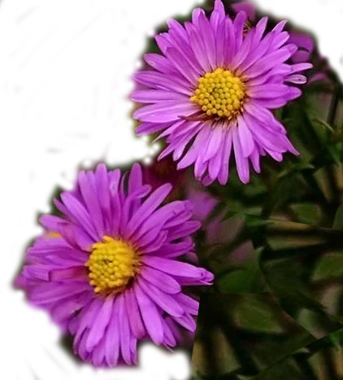
Graduating as Certified Master Gardeners
Kerry Adam
Lisa Marie Barbieri
Jeanine Beisel
Michele Bevington
Cheryl Cass
Amanda Christensen
Jody Douglas
Christine Hall
Laurie Holland
Pattie Kindsvater
Karen McCluksey
Laura Paige Moses
Tamara Newman
Shannon Patty-Stoddard
Karen Vaught
Heidi Vierow
Chris von Simson
Serena Wilson
Janet Yannucci
Brigitte Zarlenga

Slide 16
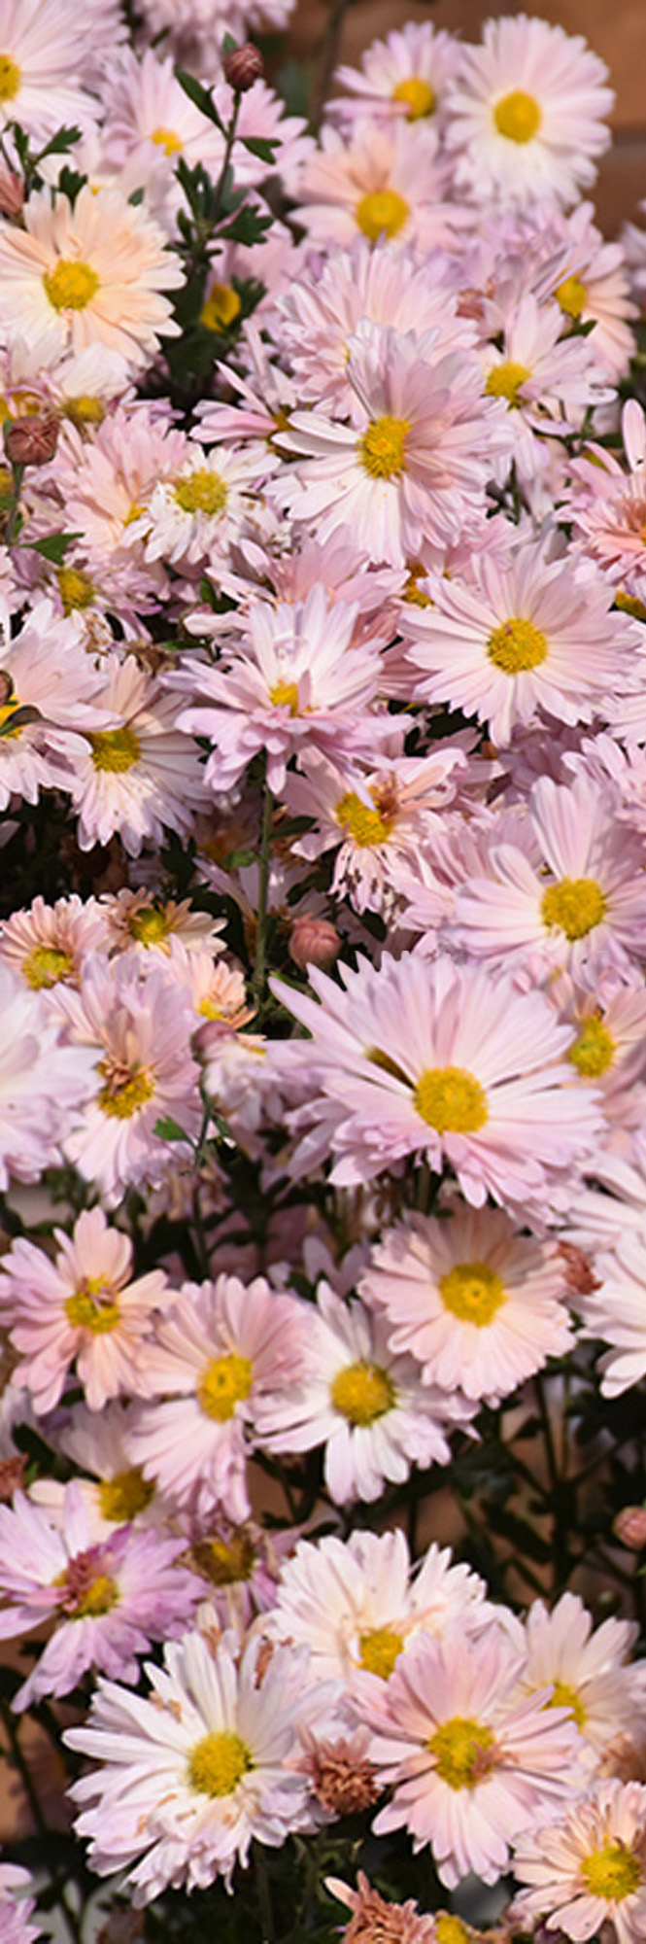
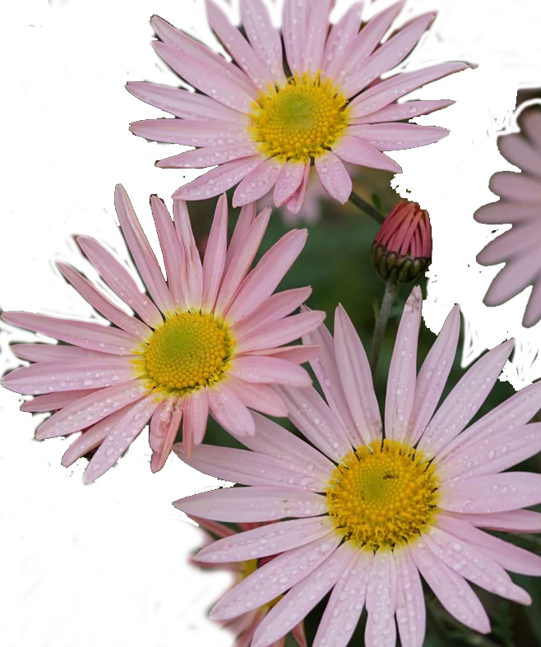
250 Hour Service Award
Karen Bell
Simon Bell
Julie Carpenter
Jayme Huleatt
Rosanne Jones
Brian Lathrop
Carlotta Moulder
Jan Pickrel
Chris Temple
Toshiko Uchiyama
Debbie Wagaman
Randall Weidman
Christina Wenks

Slide 17
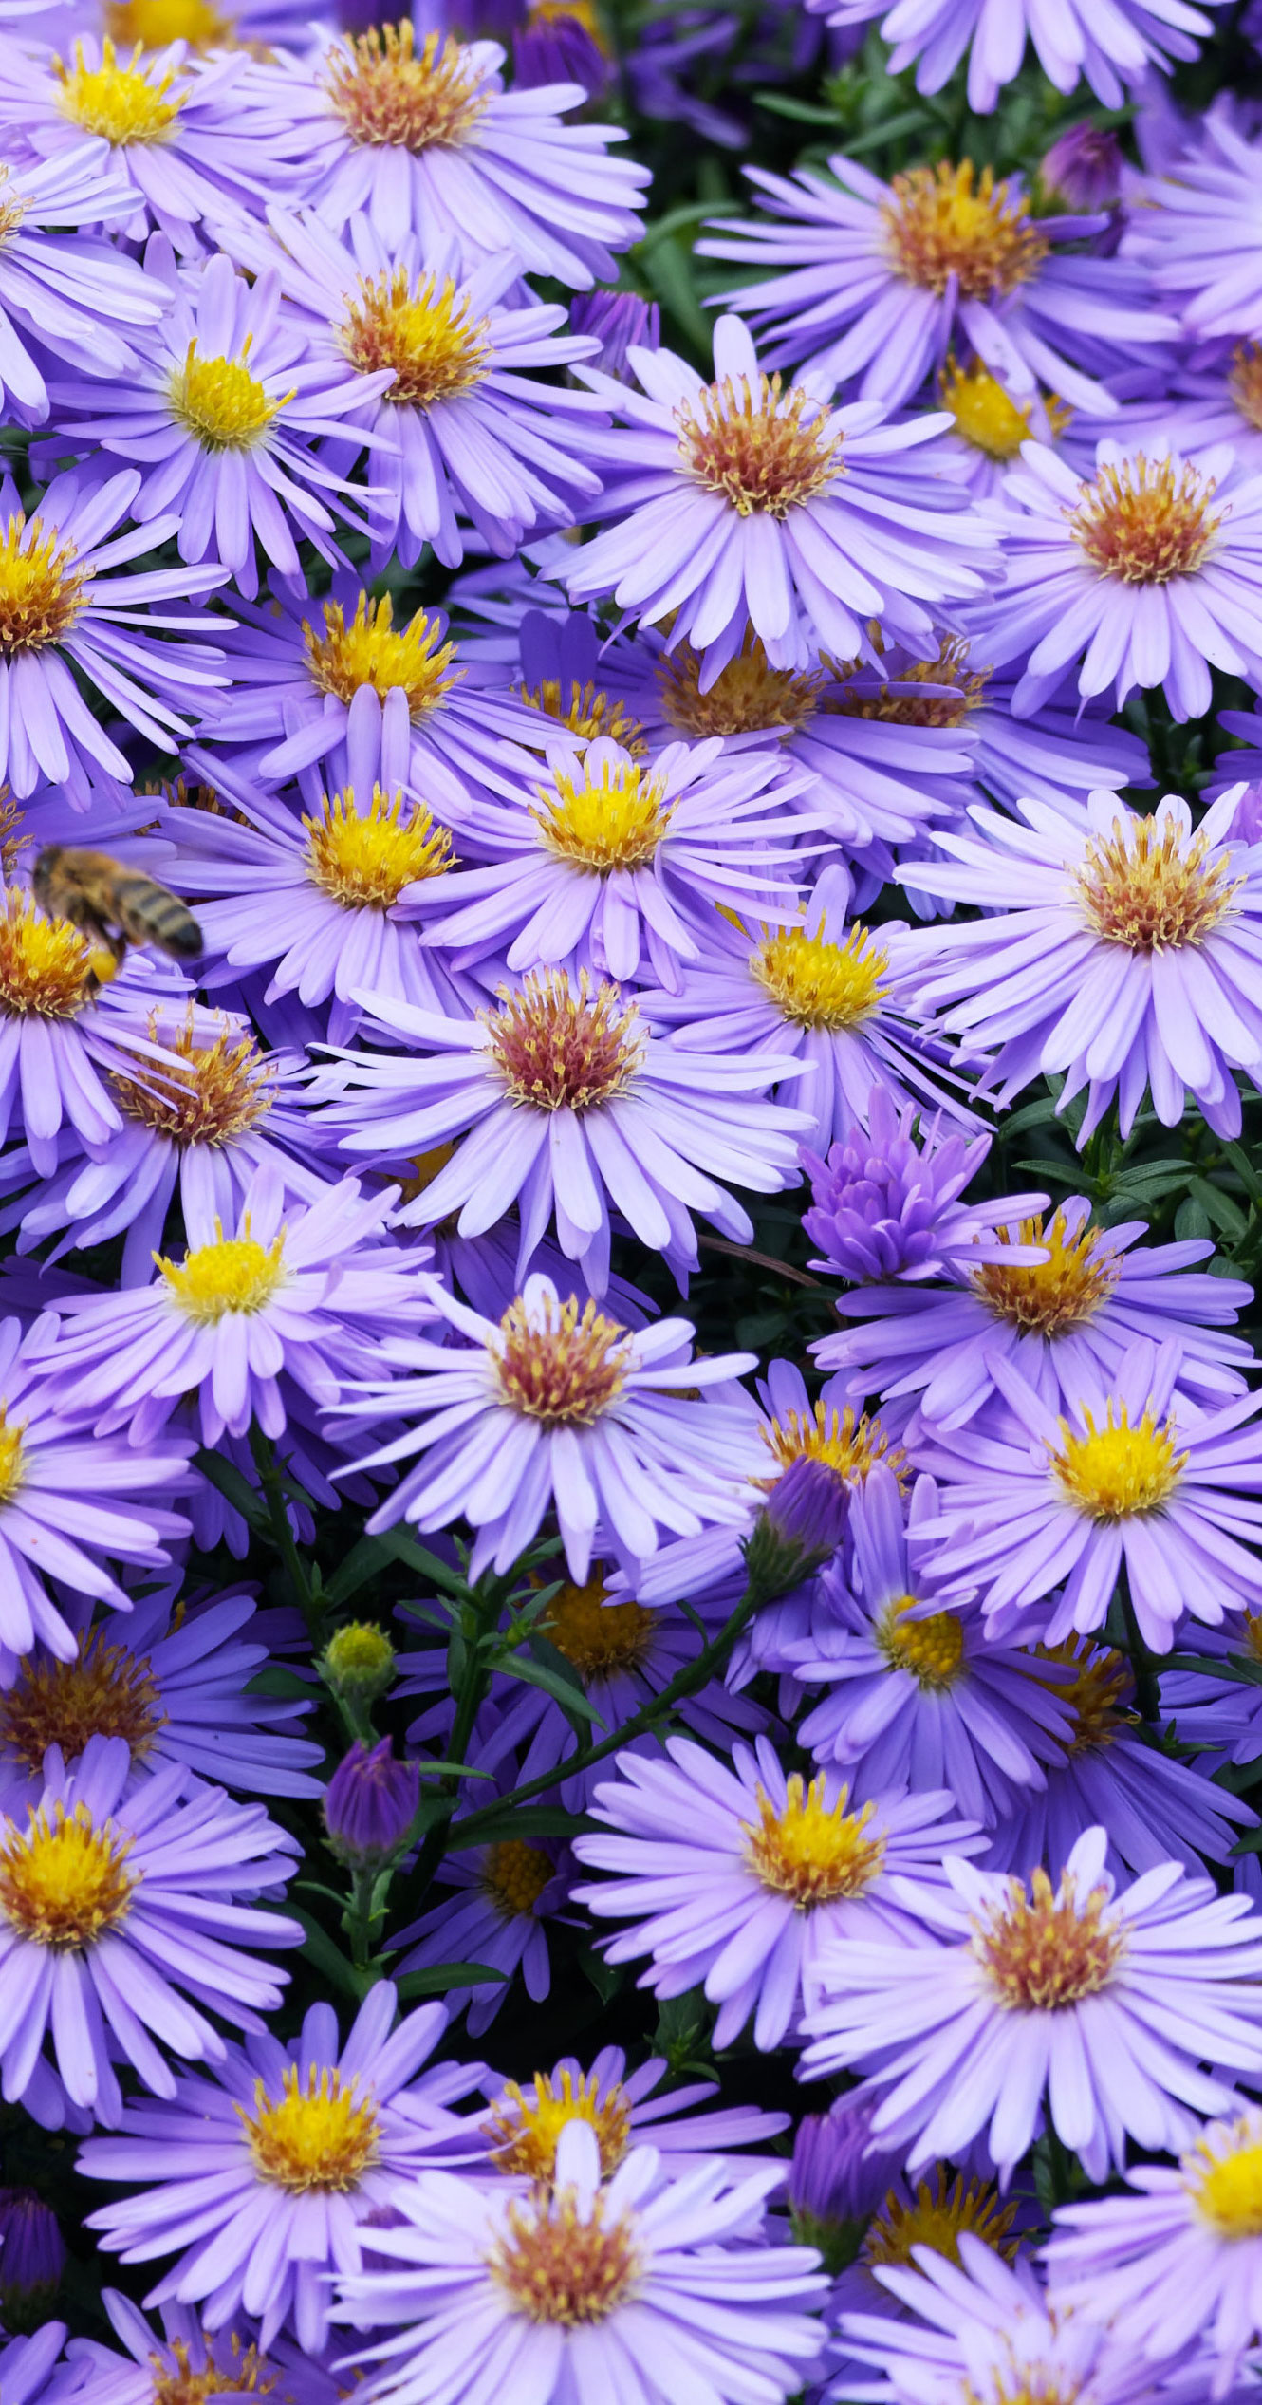
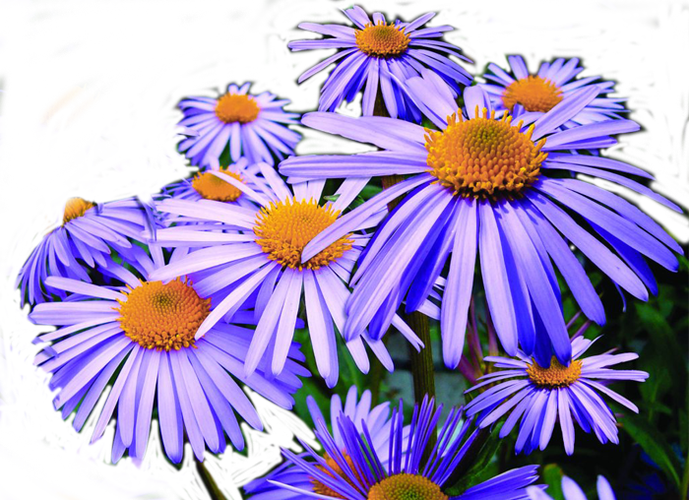
500 Hour Service Award
Yvonne Griggs
Cindy Metcalf
Nancy Moats
Deb Mullan

Slide 18


1,000 Hour Service Award
Andrea Bowles
Beth Janik
Linda Mallery
Sharon Morris

Slide 19

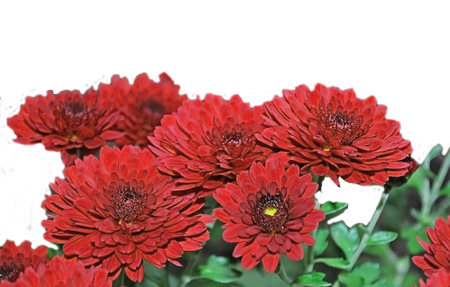
More Service Awards
2,000 Hour Service Award
Patricia Dickey
Susan McCullough
6,000 Hour Service Award
Christie Nix
7,000 Hour Service Award
Christie Nix

Slide 20
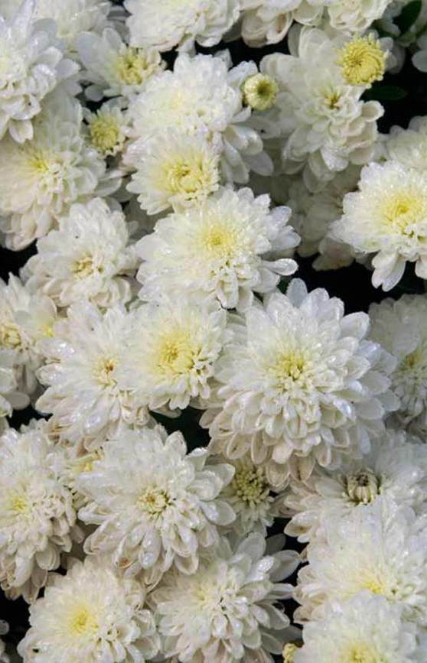

Emeritus Master Gardeners
Anita Abbruscato
Frank Abbruscato
Molly O’Boyle
Jane Broderick

Slide 21



Slide 22
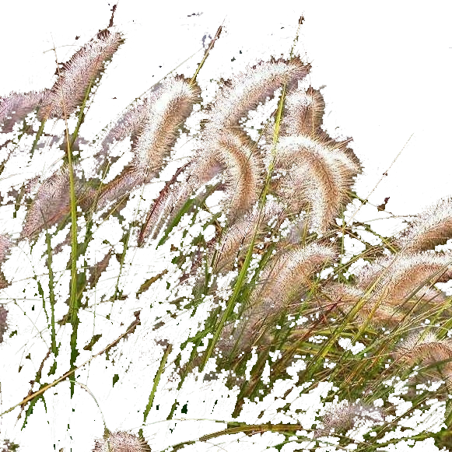
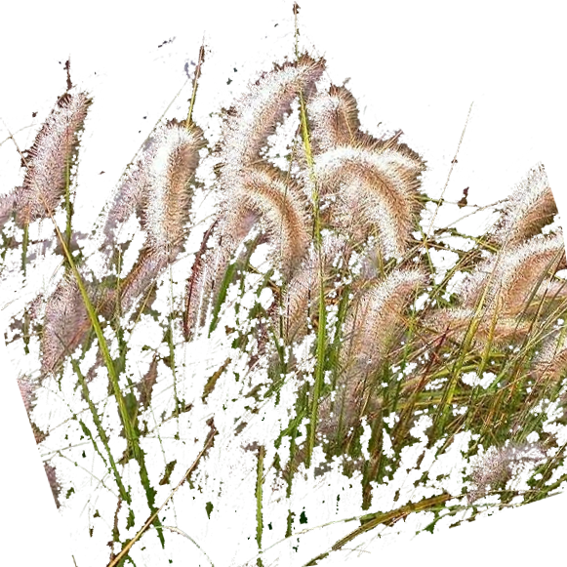
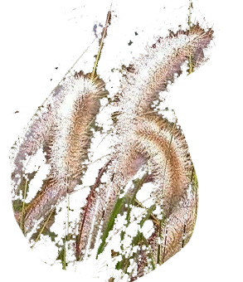
Thank you
• David Yost and the Merrifield Garden Center
• The Amazing support teams that help our FCMGA Board
• The Registration Team
• All the folks who contributed food to this amazing Potluck this evening
• The Setup and Cleanup Teams this evening
• Ray Novitske for designing and helping prepare the slides this evening

Slide 23

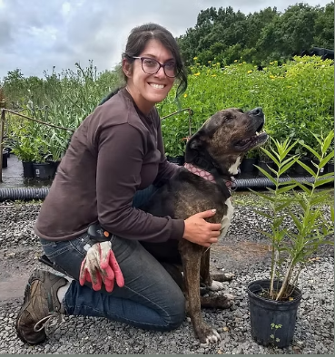
Keynote Speaker
Karen Tavakoli
Karen is an ecological landscape designer and founder of Karen for Nature. Over the course of her career, she has grown more than 4 million native trees, shrubs, and perennials, helping to restore habitat and strengthen ecosystems across the region. She creates resilient landscapes with native plants that support pollinators, heal the land, and inspire communities to design with nature. Karen also educates and presents widely, sharing her knowledge through engaging talks and workshops.

